Slide 1
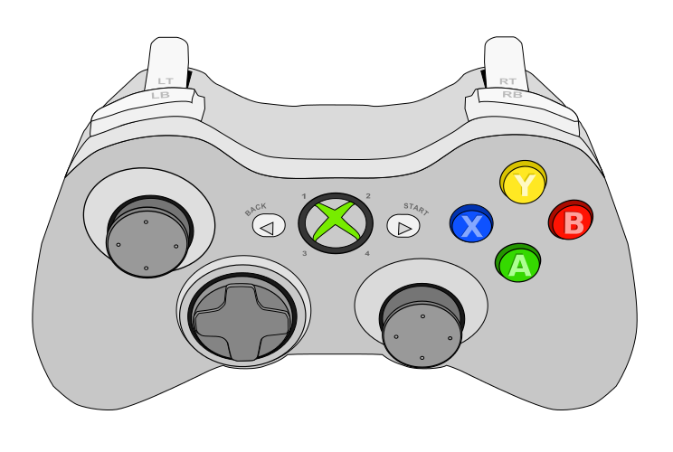
Controller 1
Drive Forward
Strafe Left
Strafe Right
Drive Back
Turn Left
Turn Right

Slide 2
Controller 2
Split Boxes Out
Suck Boxes In
Lower Box Collector
Raise Box Collector
Raise Robot
Lower Robot
Toggle Arms In and Out

Slide 3
Controller 1 for Both
Split Boxes Out
Suck Boxes In
Lower Box Collector
Raise Box Collector
Drive Forward
Raise Robot
Strafe Left
Strafe Right
Lower Robot
Drive Back
Toggle Arms in and out
Turn Left
Turn Right

